Slide 1
The INFILTRATE effect
6 bugs in 6 months
Marco Ivaldi <raptor@0xdeadbeef.info>
#INFILTRATE20, Online

Slide 2
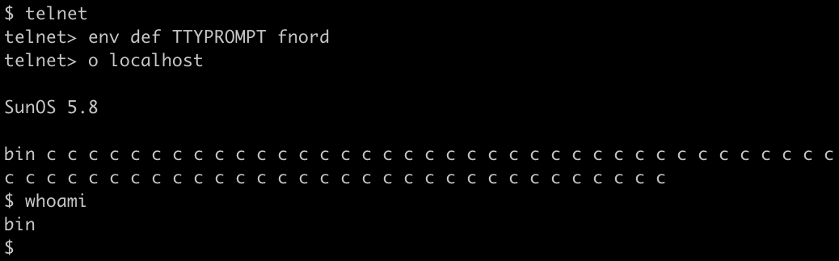

Slide 3

CVE-2001-0797
Solaris login
??? - December 2001

Slide 5
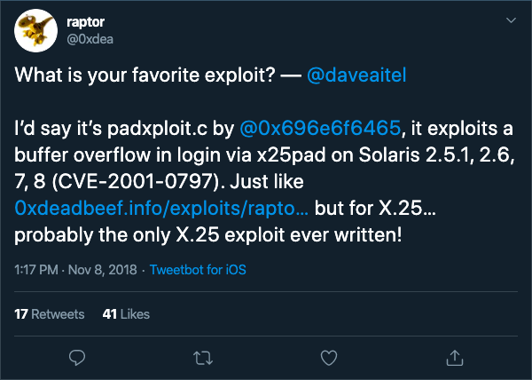

Slide 6
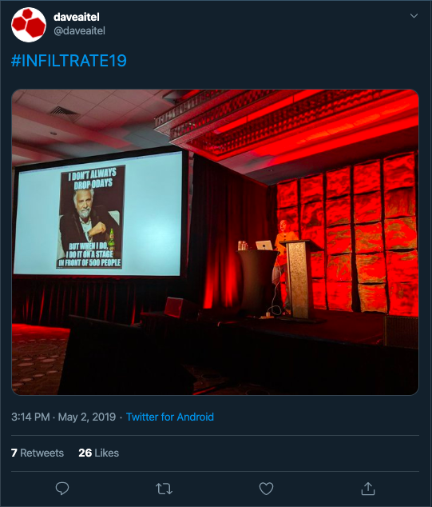

Slide 7
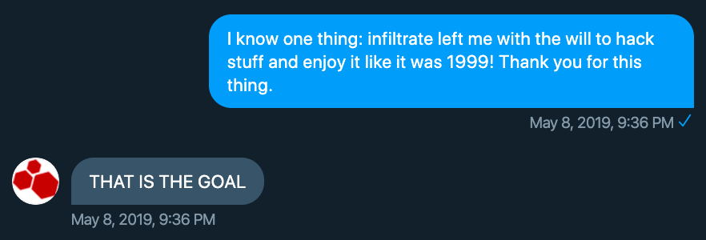

Slide 8
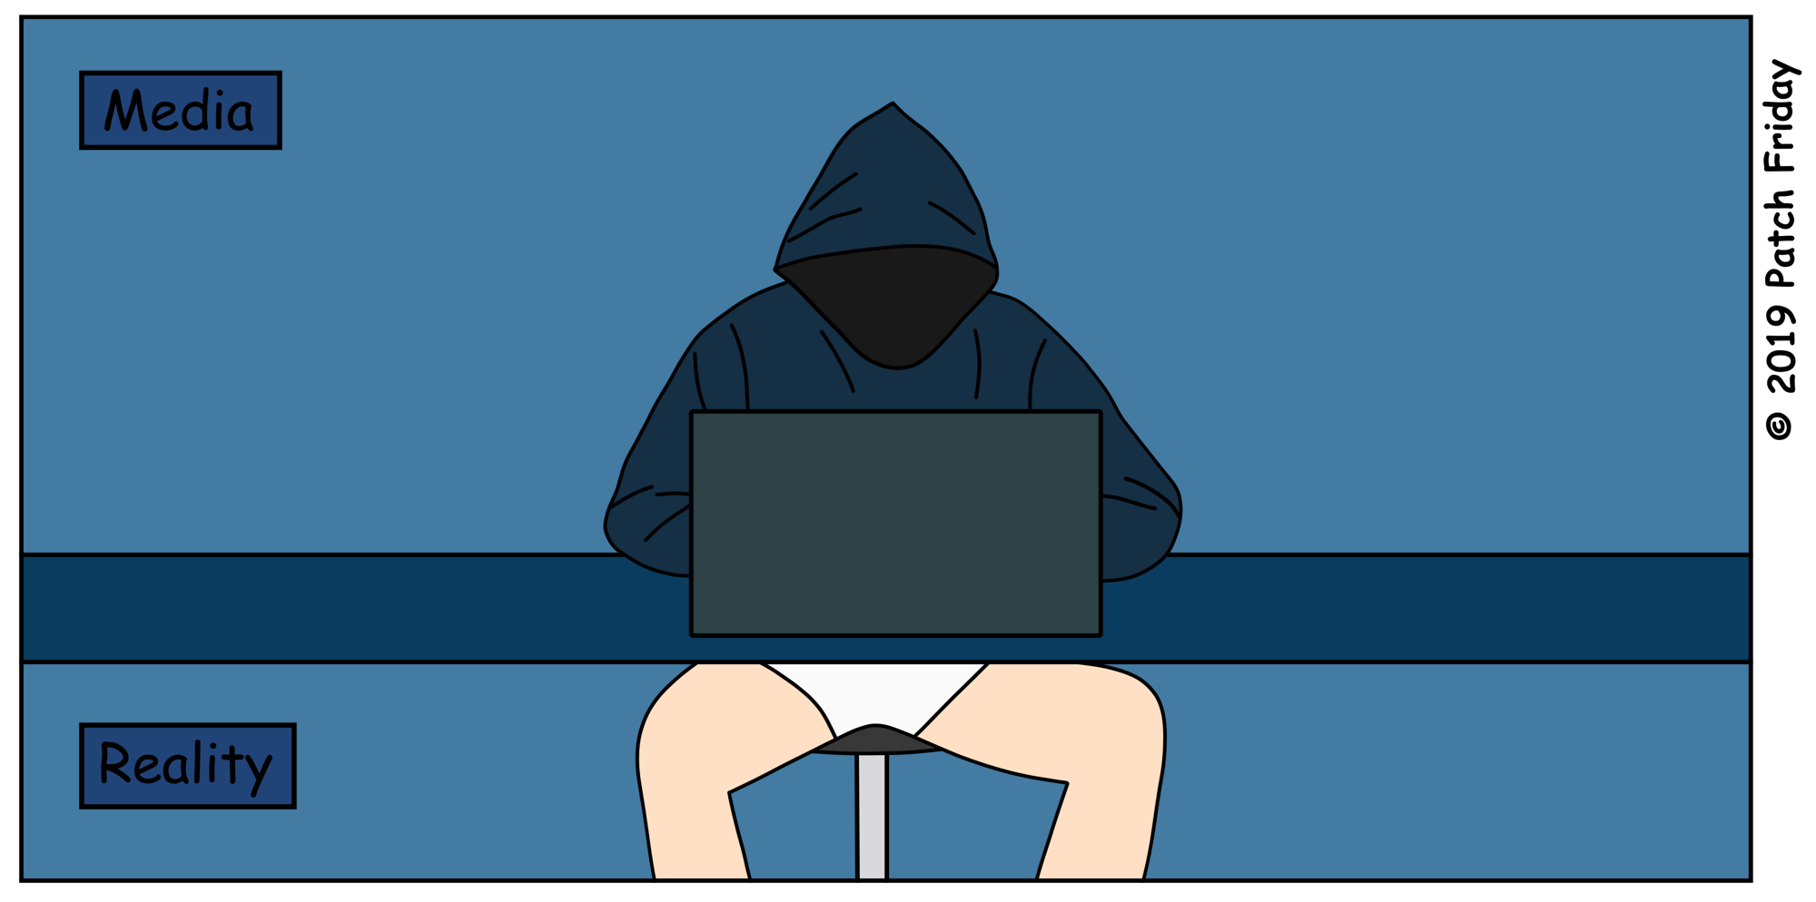

Slide 9
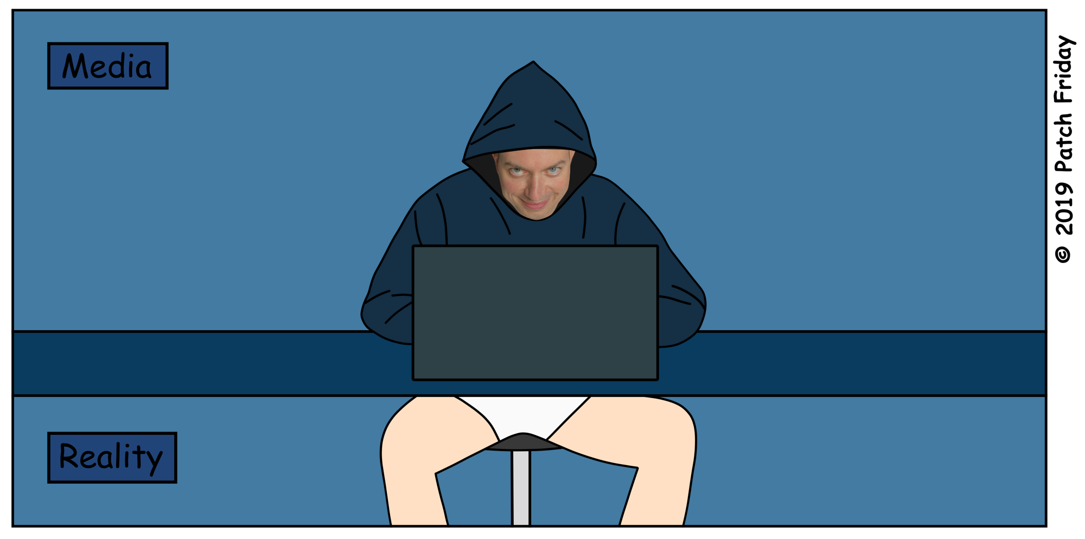

Slide 10

“How can you become
a vulnerability researcher?”

Slide 11
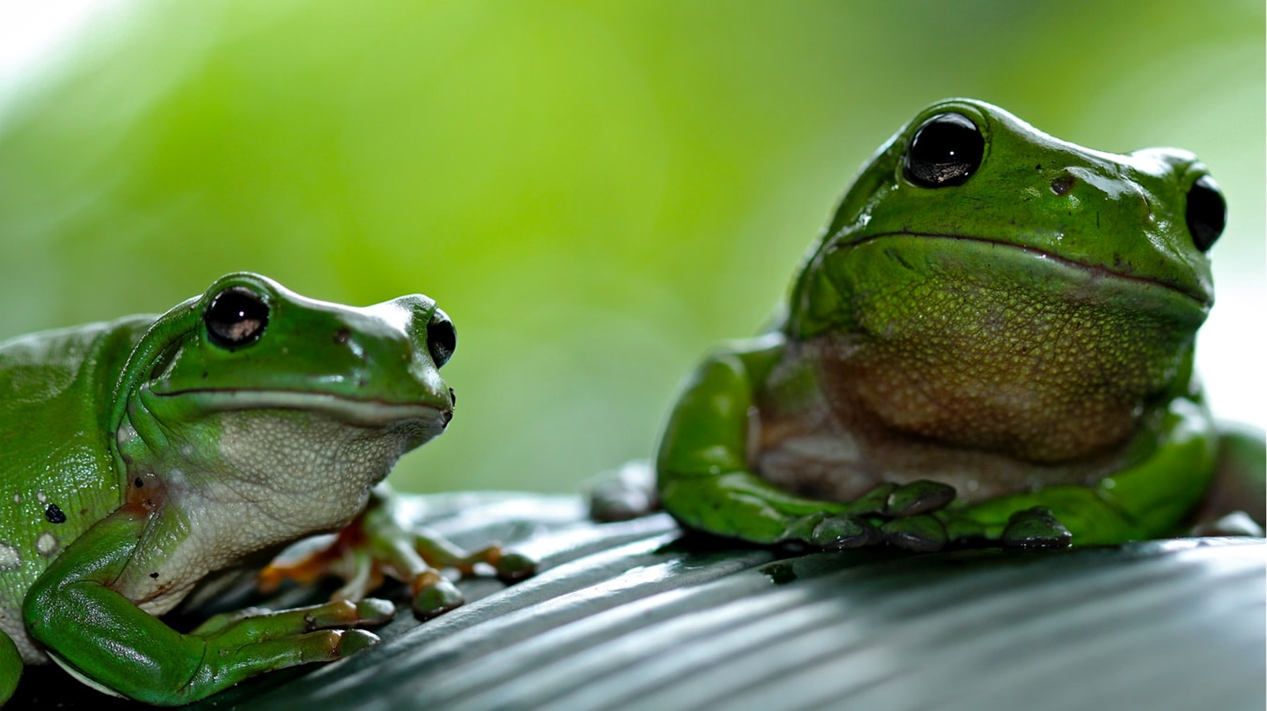
code auditor
exploit writer

Slide 12


Slide 13
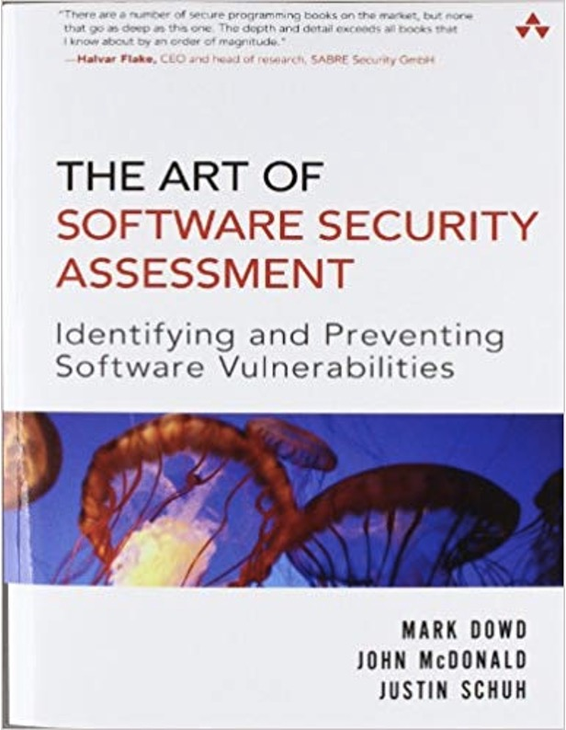
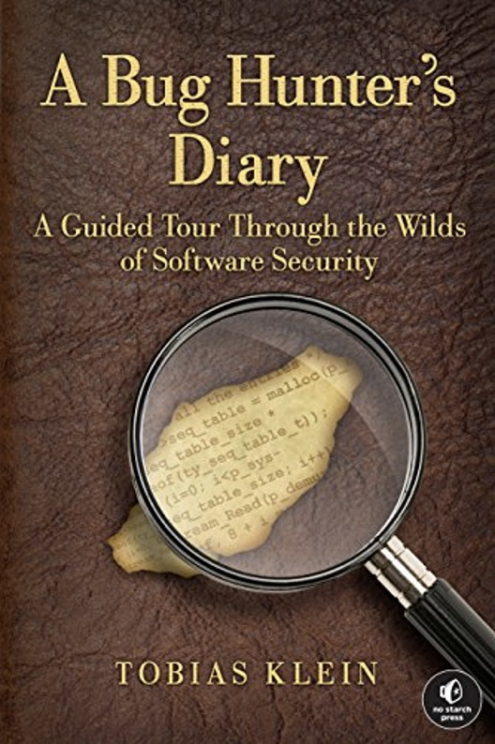

2006
2011

Slide 14
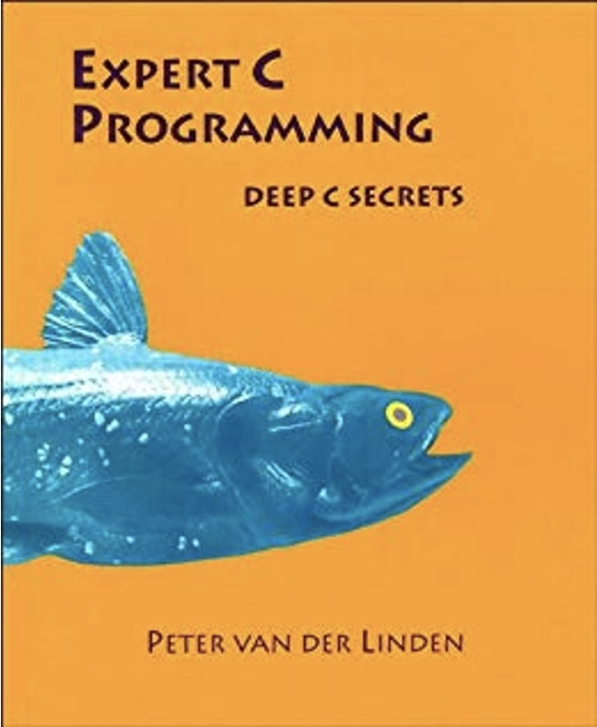
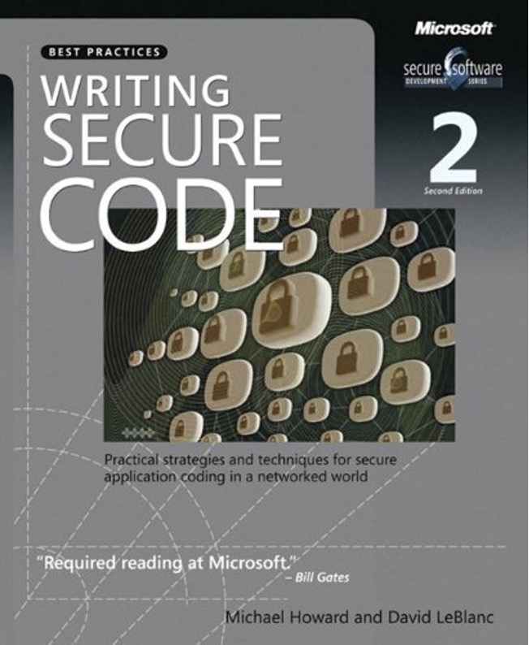
1994
2003

Slide 15
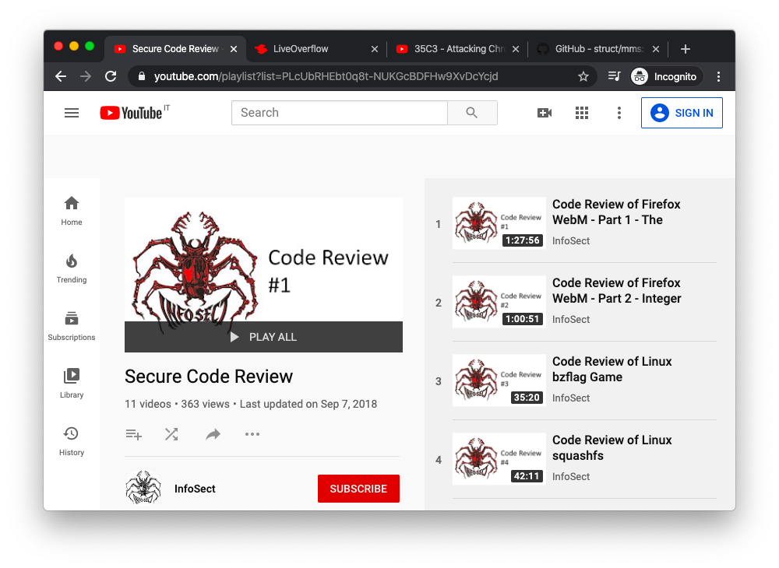
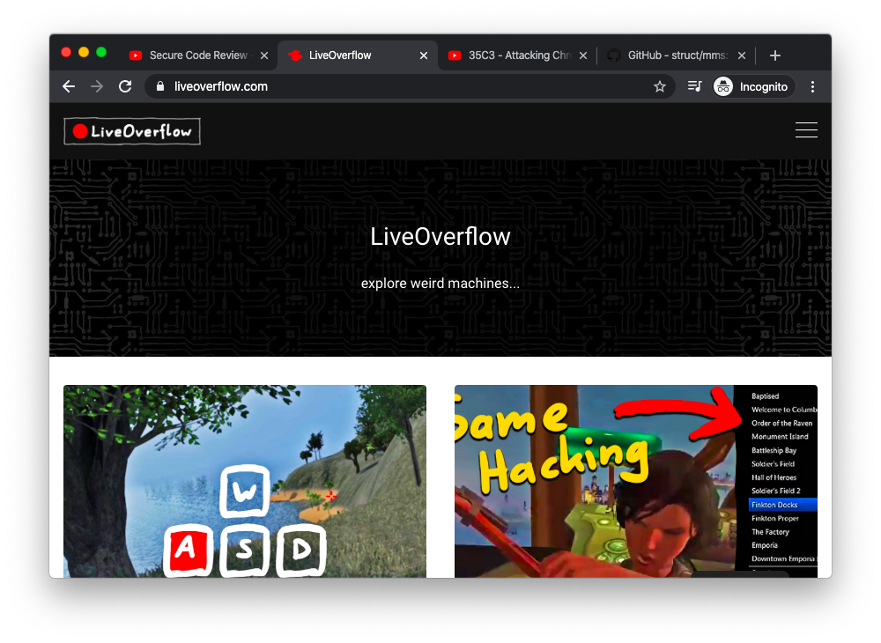
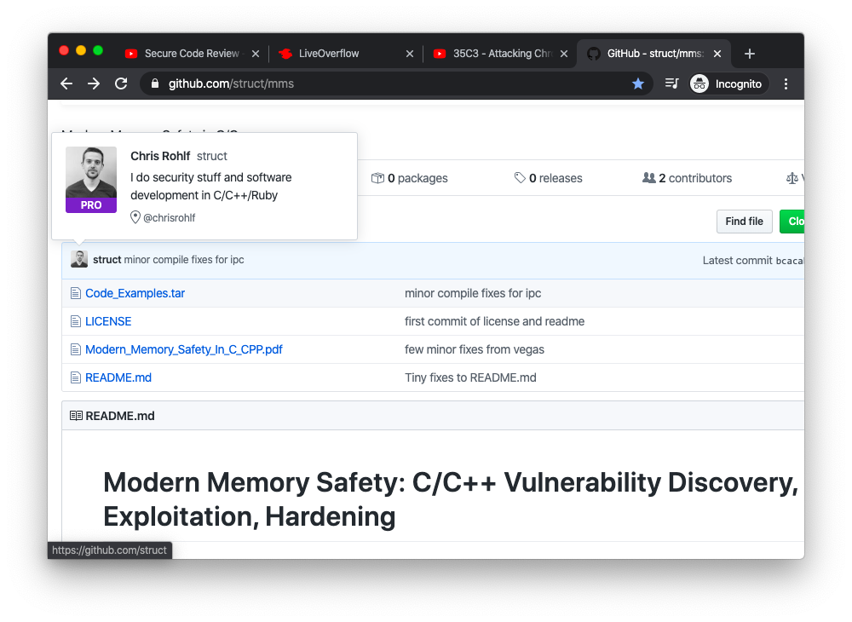
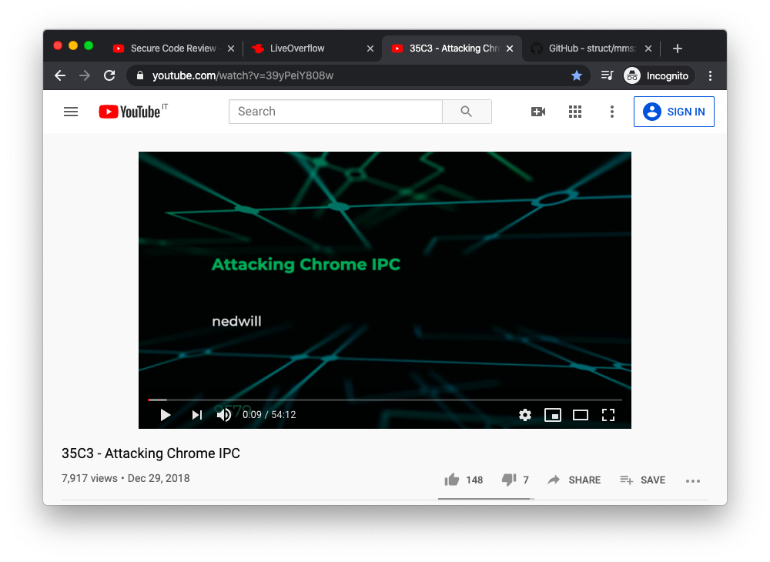
Silvio Cesare
LiveOverflow
Chris Rohlf
Ned Williamson

Slide 16

“Get your
hands dirty!”

Slide 18
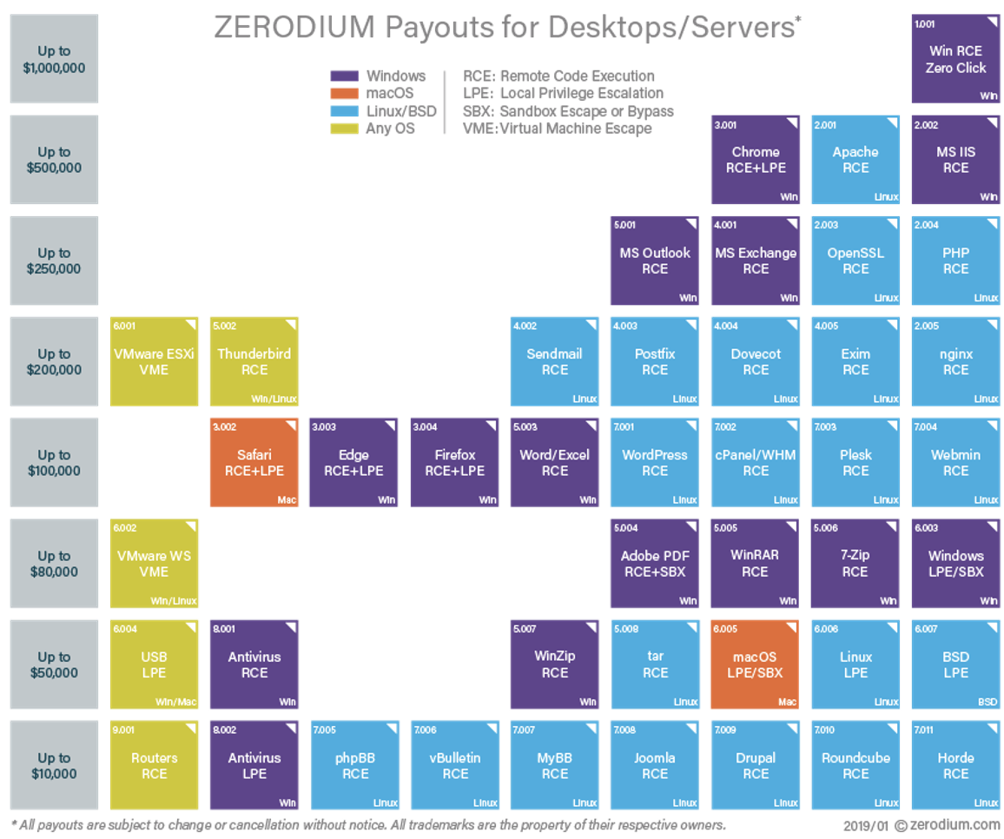

Slide 19

“Your bug,
your choice.”

Slide 20
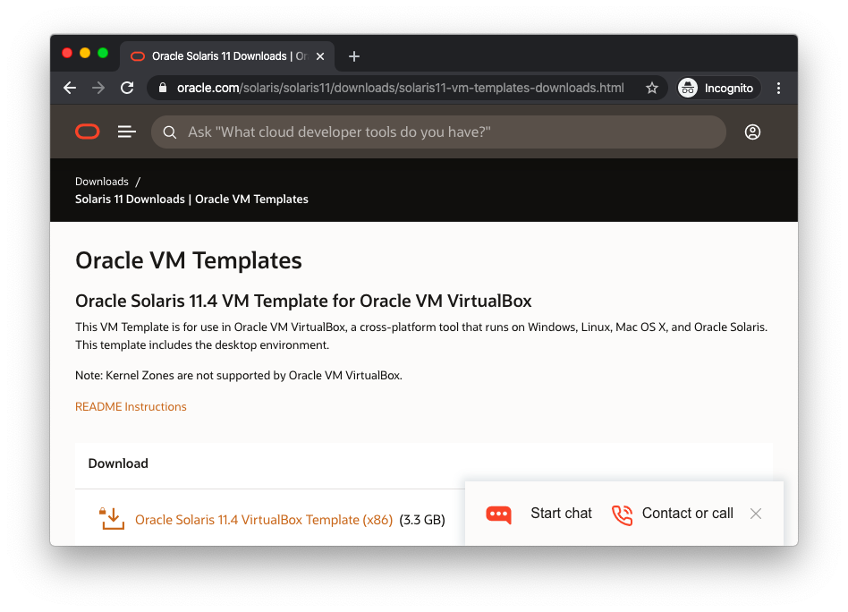

Slide 21


Slide 22
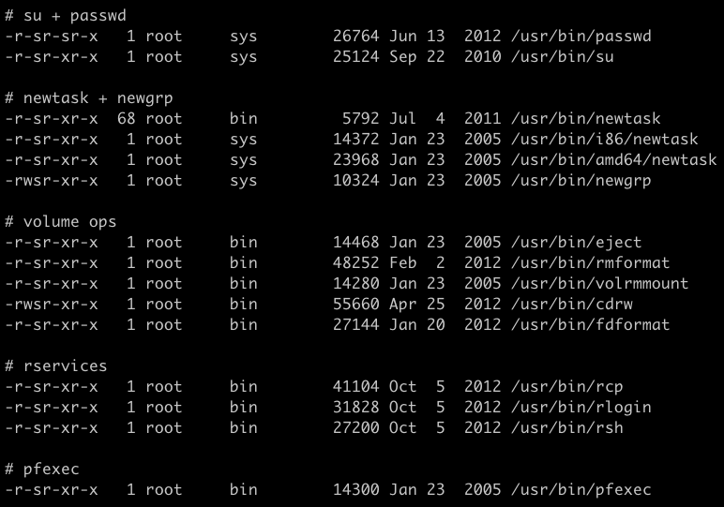

Slide 23


Static analysis
IDA Pro
Ghidra
VS Code

Slide 24

“Only the binary
can tell you the truth.”
Chris Rohlf

Slide 25

“Let your brain
process in the
background.”

Slide 26
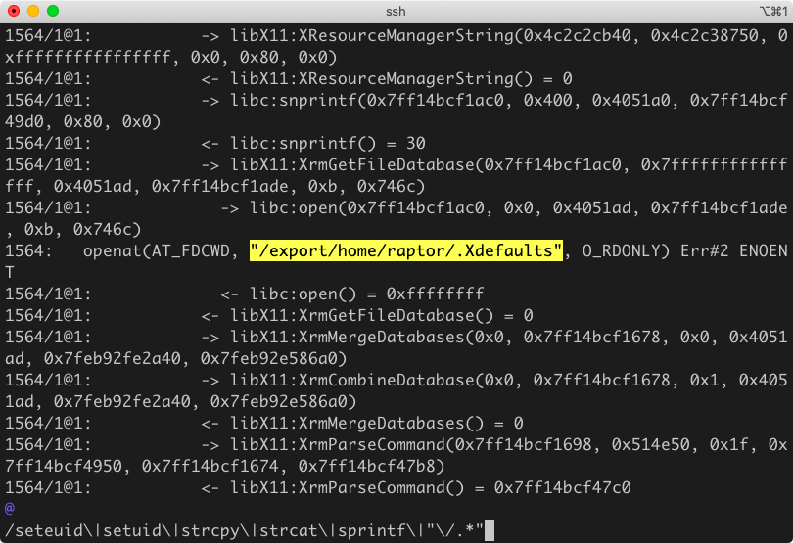
Dynamic analysis

Slide 27

“Understand,
not fuzz.”

Slide 28

Reading the docs

Slide 29
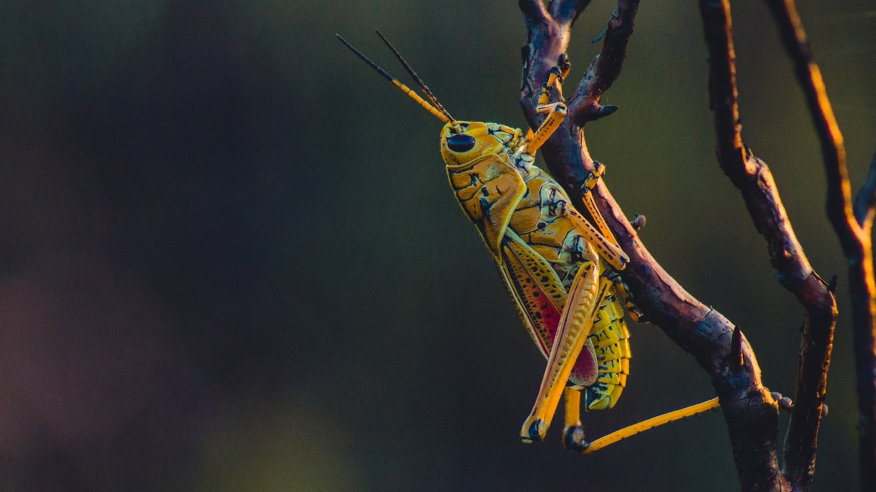
“Read,
but don’t believe.”

Slide 30
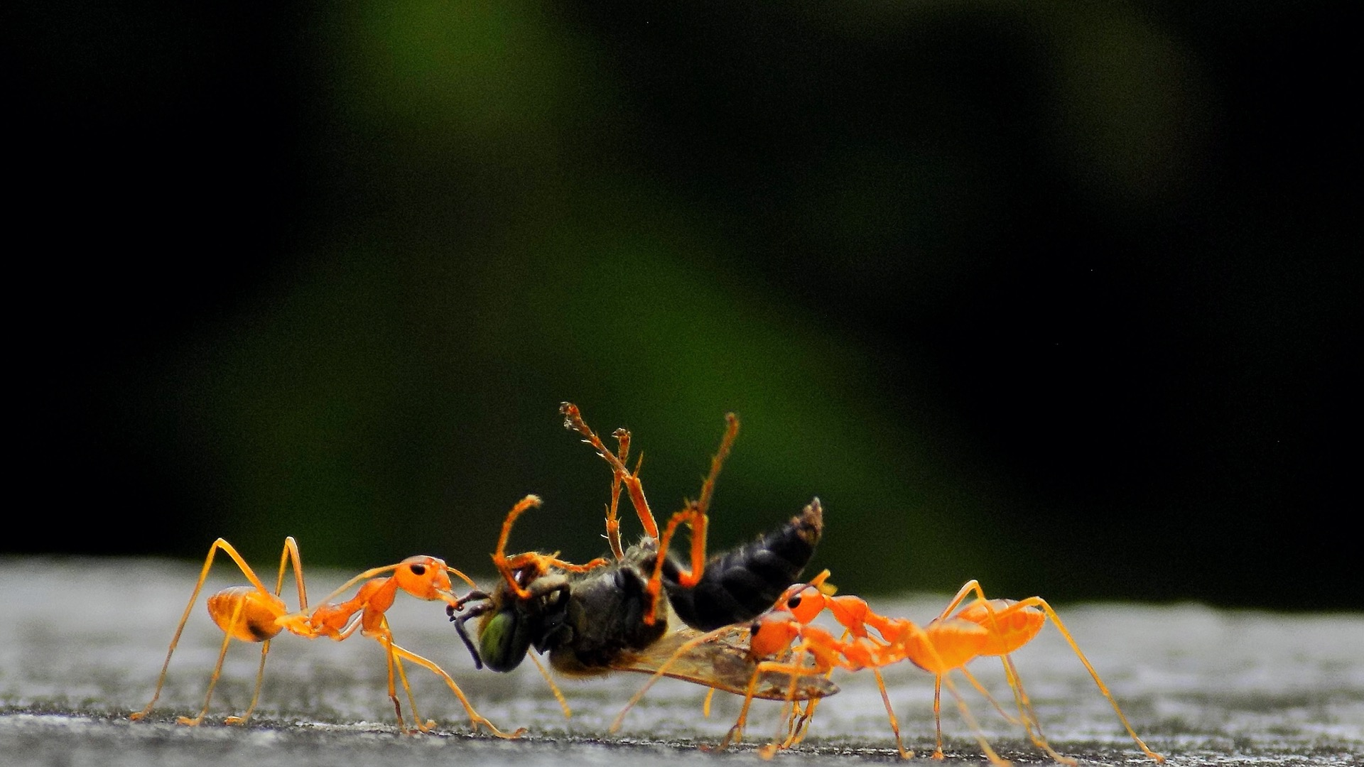
“Bugs are by far the largest
and most successful class of entity.”
Encyclopedia of Animal Life

Slide 31

CVE-2019-3010
Solaris xscreensaver
July 2019 - October 2019

Slide 32
“I’d rather be lucky
than good any day.”
J.R. “Bob” Dobbs

Slide 33
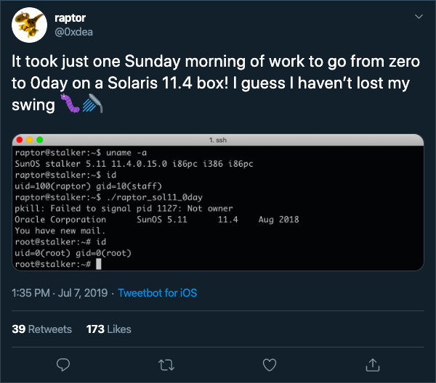

Slide 34
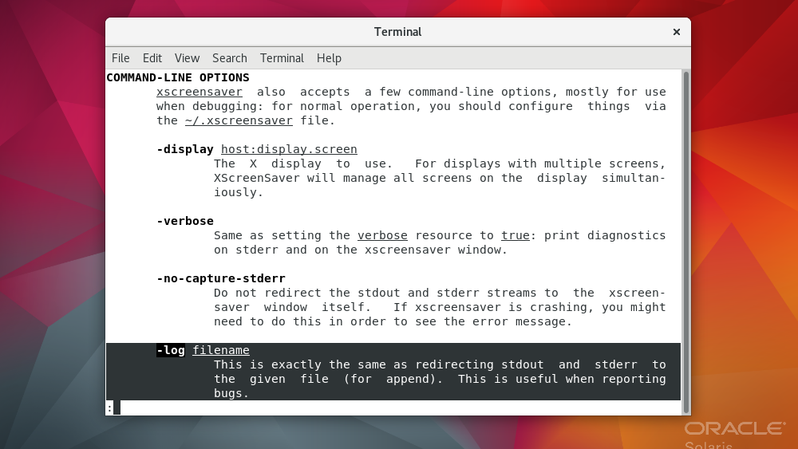

Slide 35
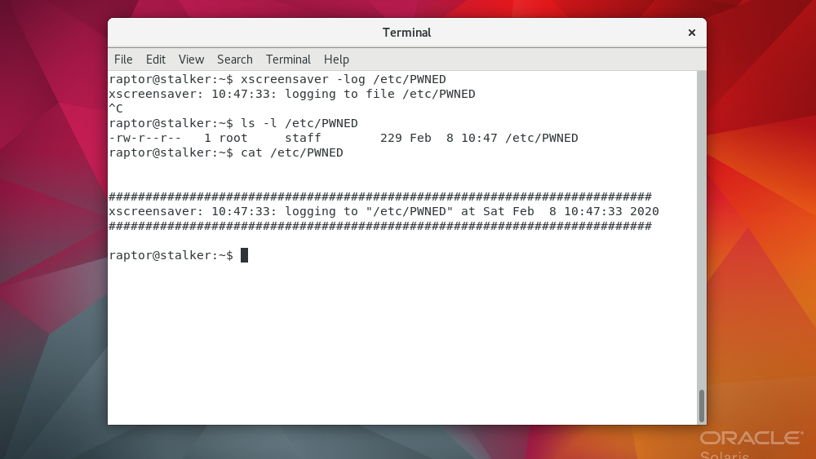

Slide 36


Slide 37
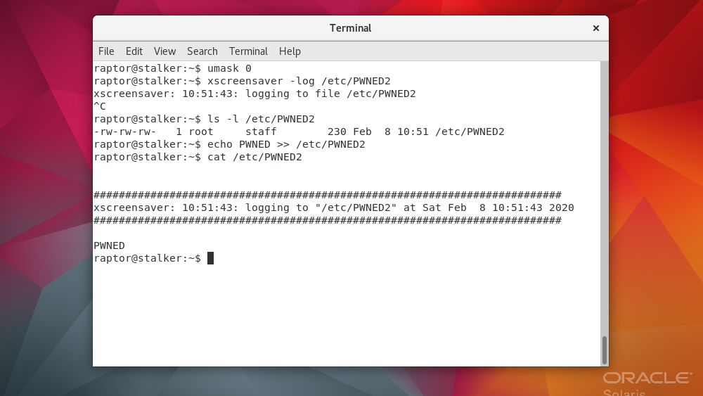

Slide 38
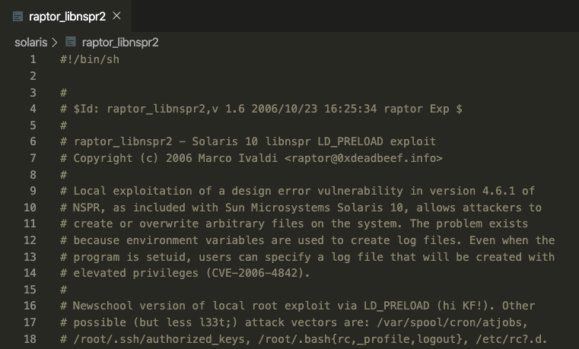

Slide 39
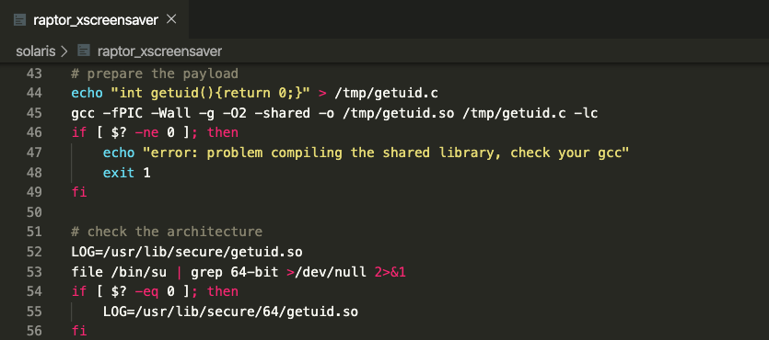

Slide 40
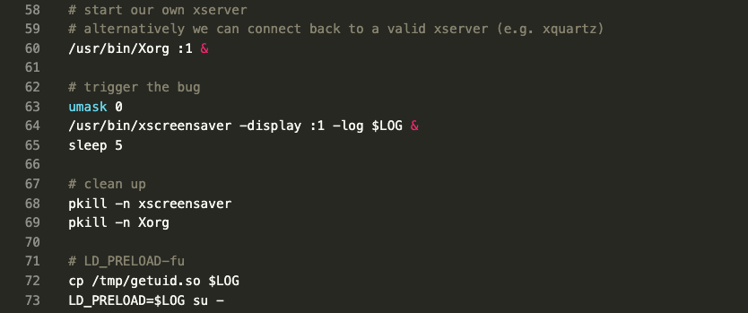

Slide 41
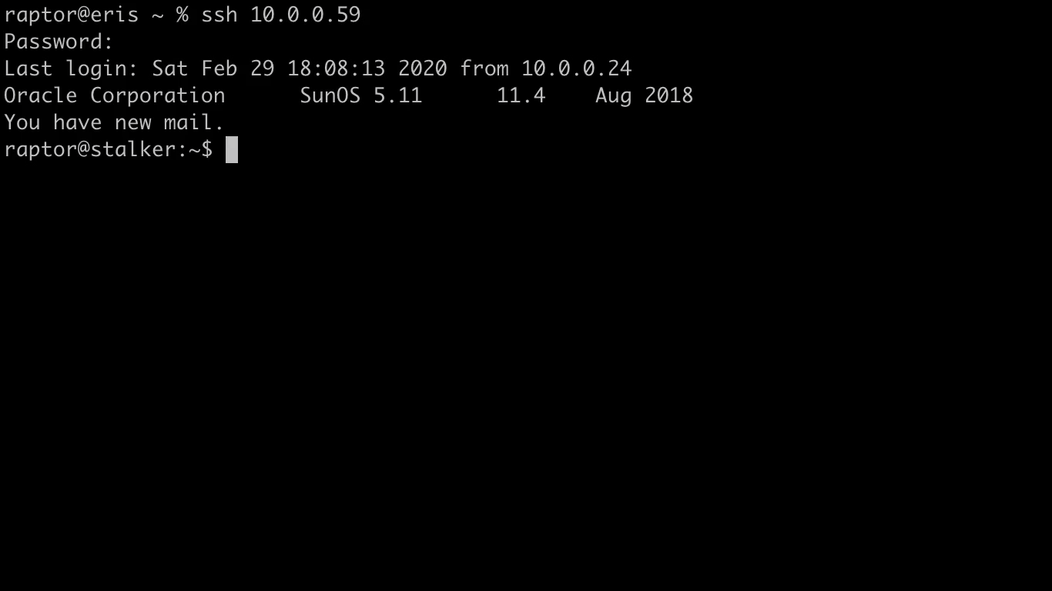

Slide 42
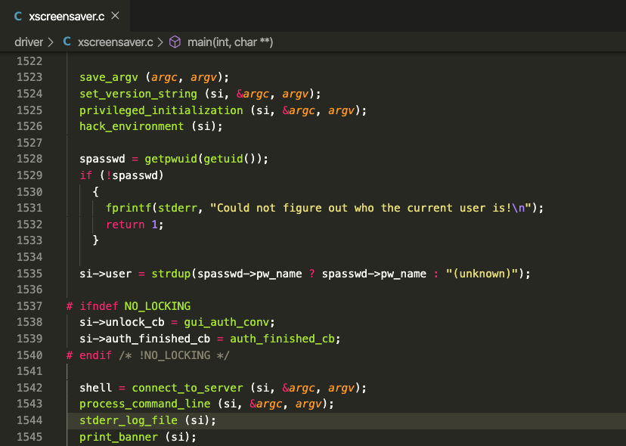

Slide 43
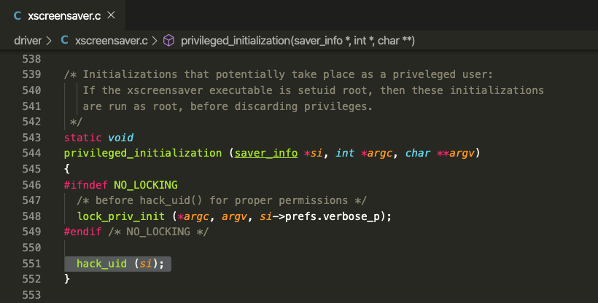

Slide 44
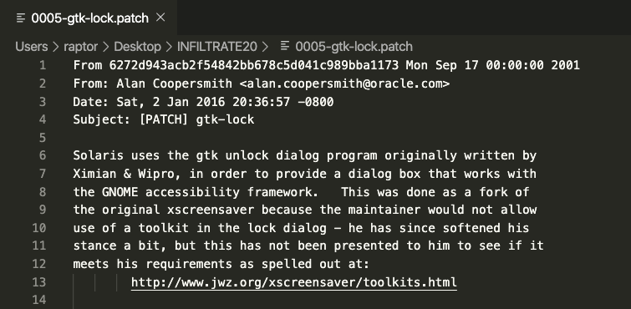

Slide 45
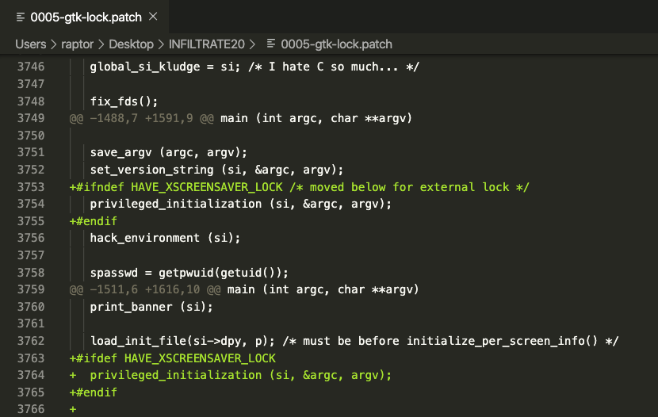

Slide 46

CVE-2020-2771
Solaris whodo
August 2019 - April 2020

Slide 47
“If I were stranded on a desert
island and could only take one data structure with me, it would be the hash table.”
Expert C Programming

Slide 48
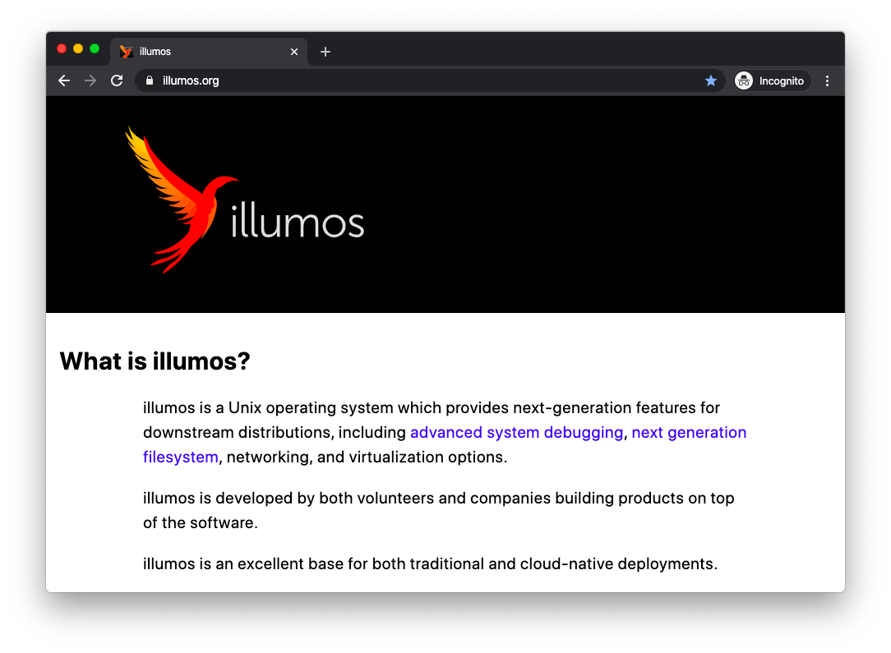

Slide 49
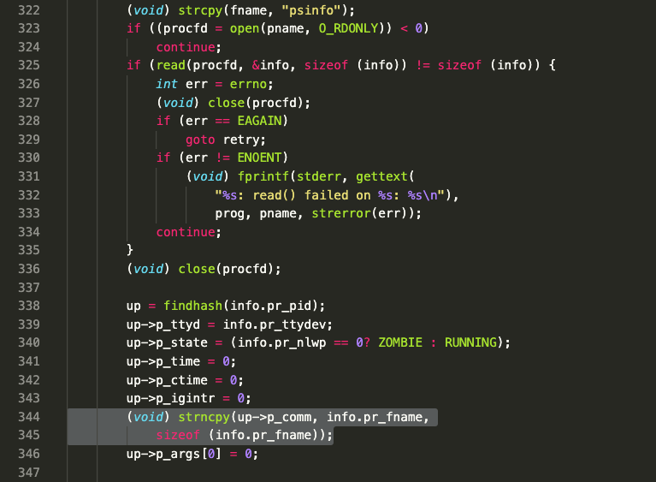

Slide 50
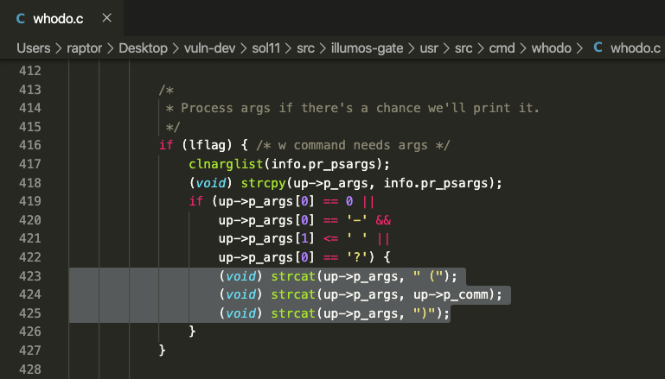

Slide 51
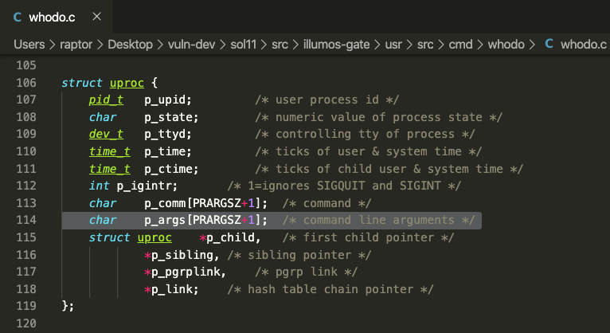

Slide 52
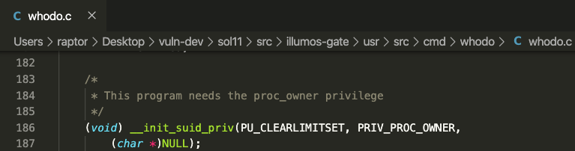
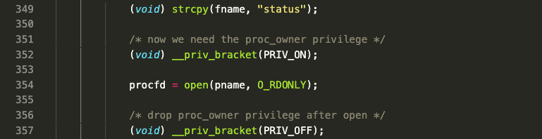

Slide 53
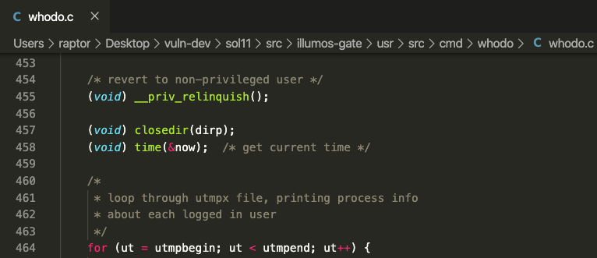

Slide 54

CVE-2020-2656
Solaris xlock
September 2019 - January 2020

Slide 55
“Have I ever mentioned
how much I love truss?”
Marco Ivaldi

Slide 57
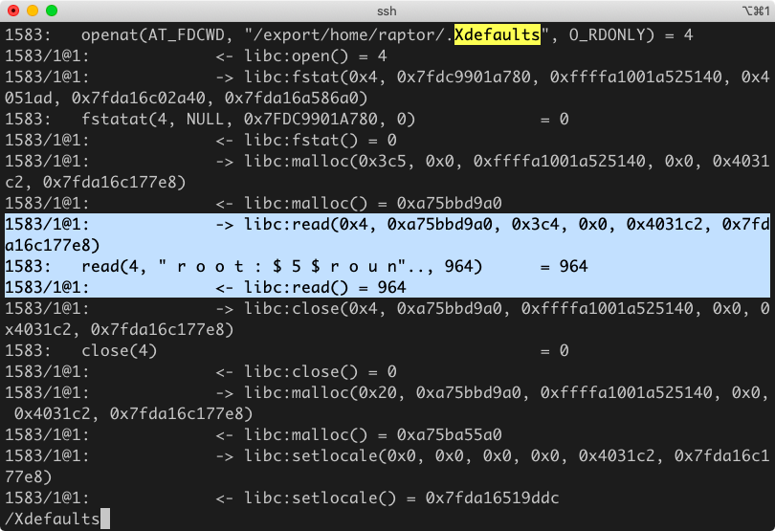

Slide 58
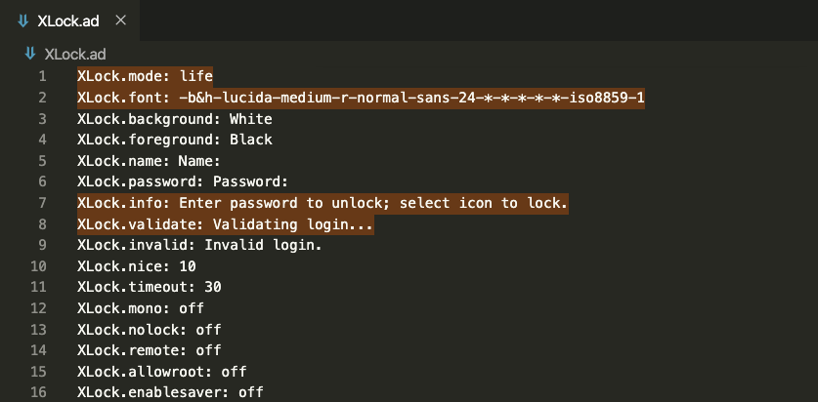

Slide 59
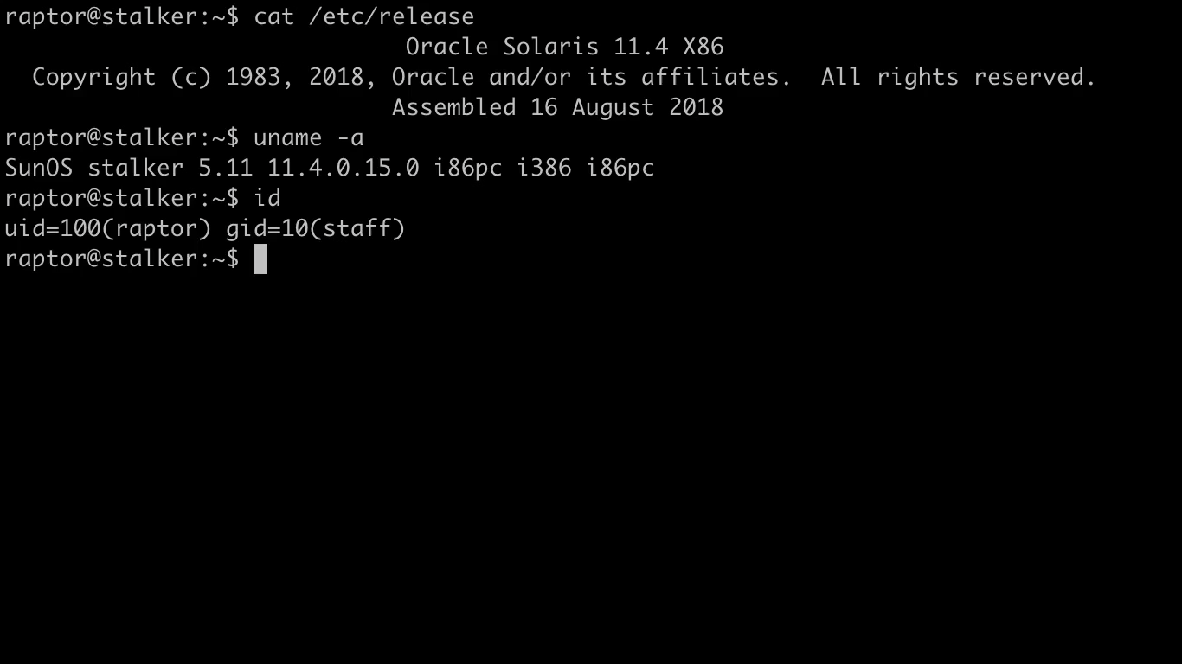

Slide 60

CVE-2020-2696
CDE dtsession
November 2019 - January 2020

Slide 61
“Are you sure
that’s not a remote?”
Dave Aitel

Slide 62
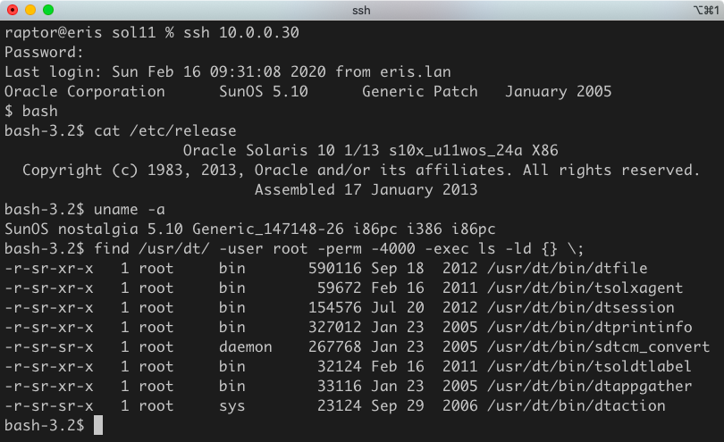

Slide 63

“Bugs are like mushrooms:
it’s hard to find the first one, but once you do, you’re usually in the middle of a whole field of them.”
Dmitry Babokin

Slide 64
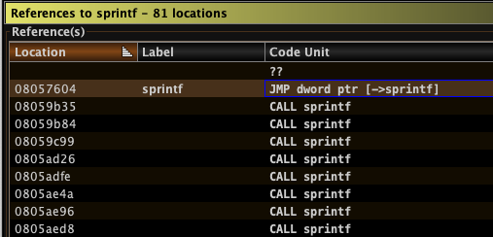

Slide 65
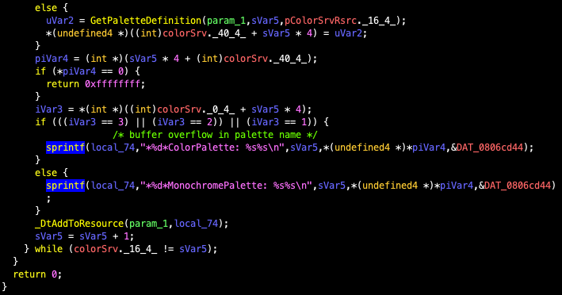

Slide 66
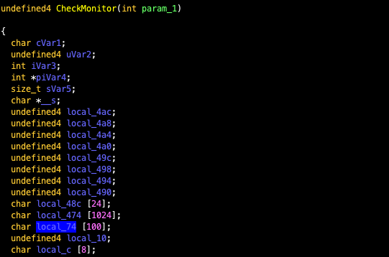

Slide 67
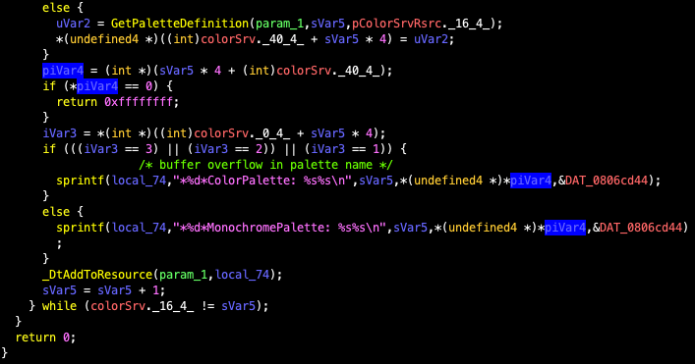

Slide 68
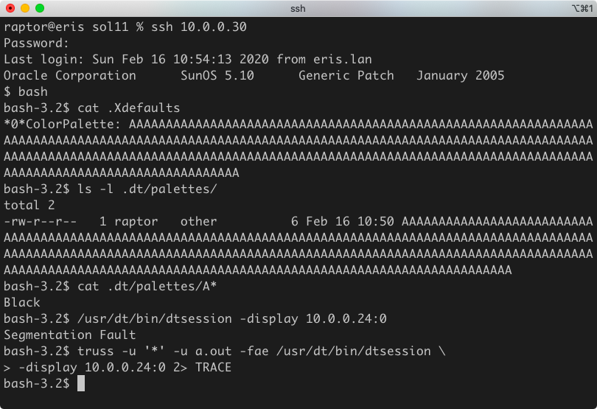

Slide 69
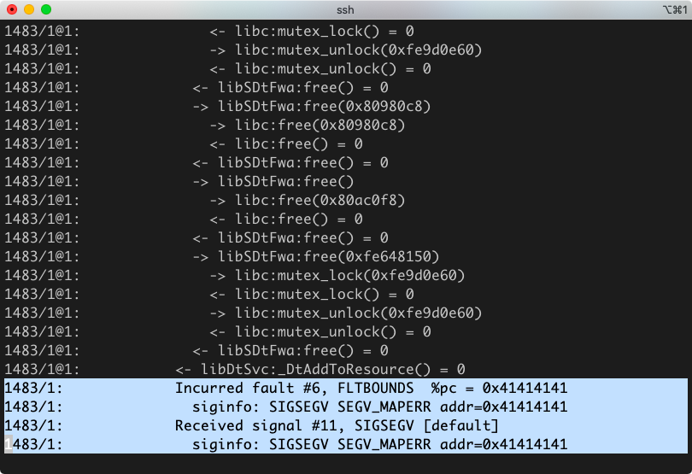

Slide 70


Slide 71


Slide 72


Wh00h00!

Slide 73

CVE-2020-2944
CDE sdtcm_convert
December 2019 - April 2020

Slide 74
“Pay special attention to
code that has a history of vulnerability.”
Writing Secure Code, 2nd Edition

Slide 75


Slide 76


Slide 77


Slide 78


Slide 79


Slide 80


Slide 81

CVE-2020-2851
CDE libDtSvc
December 2019 - April 2020

Slide 82
“All memory corruption
vulnerabilities should be treated as exploitable.”
The Art of Software Security Assessment

Slide 83


Slide 84


Slide 85


Slide 86


Slide 87


Slide 88
Key takeaways
Memory corruption bugs stubbornly refuse to die.
There are still obvious bugs in widely used software.
Modern exploit mitigation techniques can’t always help.
Sometimes, old decisions come back to bite you.
Closed source programs are not more secure.
You can do it yourself!

Slide 89

“Why do a CTF,
when you can do Solaris?”

Slide 90


Slide 91


Slide 92

Question Time
https://0xdeadbeef.info
https://github.com/0xdea
https://twitter.com/0xdea
raptor@0xdeadbeef.info

